Slide 1
ASSIGNMENT
Real Time Plant Analytics Framework
Noodle Plant

Slide 2
Real Time Plant Analytics Framework Concept:
Real time plant analytics framework is a state-of-the-art platform that provides a 360° visibility of the manufacturing floor in real time.
It is important to have a 360° view of the shop floor with all relevant information in hand which ensures completeness of information that helps in the decision making process.
To create an environment where plant personnel are informed and aware about each micro event to take action immediately in real time when it matters most. Forthcoming potential losses are detected well before they damage production economics and will transform the role of production & operation team from reactive floor management to proactive & predictive management by making the right decisions in real time.

Slide 3
Approach to Real Time Plant Analytics Framework
Case Study: Soap Noodles Moisture variation in Vitavon AL Batch No: B071600278
Understanding the soap noodles manufacturing process.
Data Capturing and report generation from scada.
Trend Analysis and Alarming
Analyse the factors affecting the Soap Noodles quality in terms of Moisture % age
Fixing the tolerances of Max. and Min. limits of the parameters affecting the moisture %age.
Control of Noodles Moisture% age
Tuning of the system with the help of VLS pressure, Steam Pressure or neat soap flow control.
Finally outcome of the project and Way Forward.

Slide 4
Plant Functioning
D.F.A.
TURBO-MIXER
REACTOR
QUALITY CONTROL
CRUTCHERS
DYNAMIC MIXER
FEED TANK
HEAT EXCHANGER
VAPOUR LIQUID SEPERATOR
NOODLE
SPRAY DRIER

Slide 5
Data Capturing &Report Generation from Scada
Report generation based on the set parameters on hourly basis:-

Slide 6
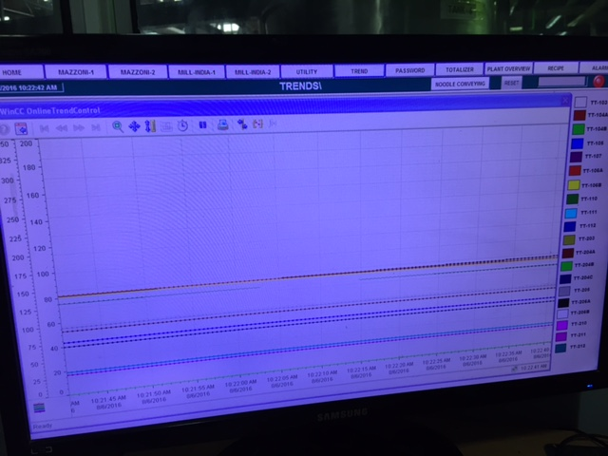
Trend Analysis:-
IN scada we can see the trends of different parameters which are fixed for a particular SKUs after every 5 Minutes.
Operator can Analyse the readings and can take the corrective actions before the final product get produced.

Slide 7
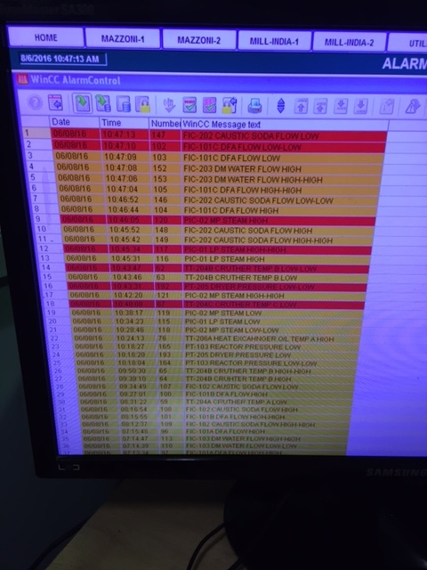
Alarm Facility:
Scada is equipped with Alarm facility which will also help to correct our process, You can see the detail of alarm in the photographs.

Slide 8
What did we get from Report Generation?
Quantity of DFA
Quantity of Caustic soda
Quantity of DM water
MP steam main set pressure
VLS pressure variation
Temperature of Neat soap at different locations
Vacuum Variation in the process
Flow rate of Neat Soap: Still Not tagged
Trend Analysis after every 5 minutes.
Alarm facility: Not used

Slide 9
Analysis of factors affecting the Soap Noodles Moisture
Data captured from plant process manually for two days and observed as:
Soap Noodles Output in KG from Plodder: Can be considered as Flow of Neat Soap: No Flow Meter for Neat soap
Setting of VLS pressure :why and when we change it
Setting of HE-1&2 Temperature : why and when it changes
Setting Steam Pressure: Why and when it requires to change

Slide 10
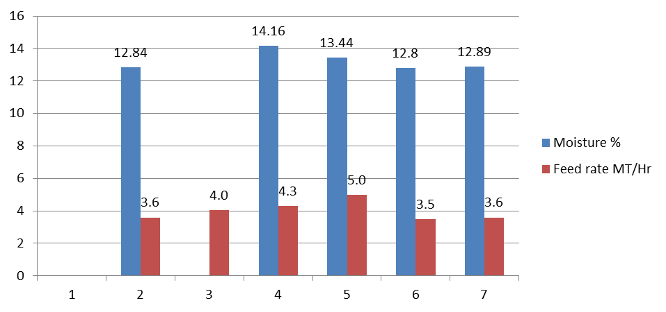
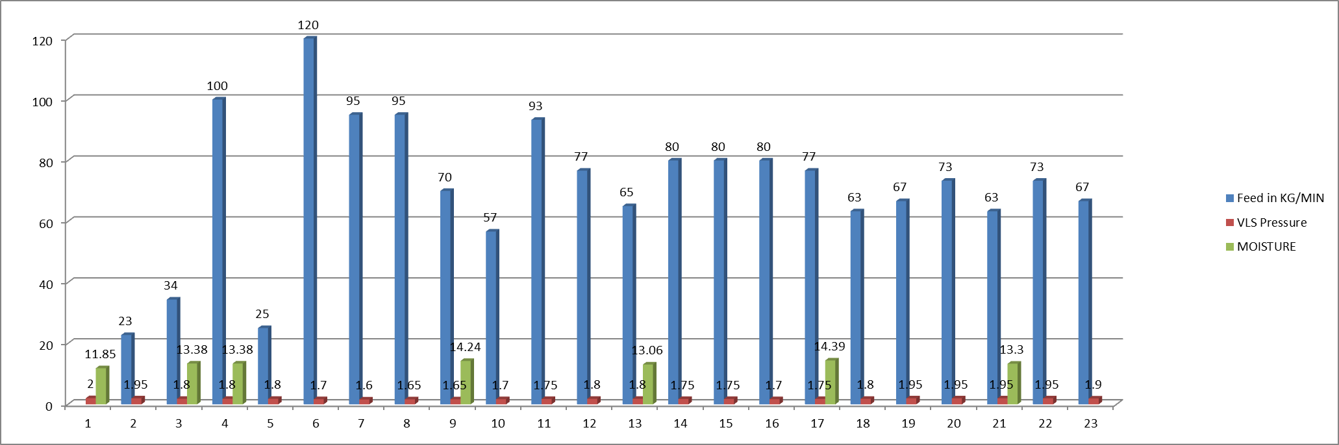
Graphical representation process data capturing manually

Slide 11
Outcome From Report
The major factor which affects the noodles moisture is the neat soap flow which varies and impact the final noodles moisture.
1st step to correct the moisture is to regulate the VLS pressure.
If noodles moisture is high, operator regulates the VLS pressure from low to high and vice versa.
As the VLS pressure is regulated the neat soap flow also regulates and correct the moisture due to back pressure on neat soap feed pump.
In hardly case operator changes the steam pressure.

Slide 12
Reasons of change of Neat soap Flow and its prevention
Major Reason:
Feed pump may not getting the constant positive suction pressure
Prevention:
Need to create the more positive pressure by keeping the bottom of feed tank at 1st floor level and changing the connected piping from 4” to 6” to its suction.
We can put level sensor in the feed tank and can get alarm below acceptable level.

Slide 13
Fixing of Process parameters Limits for different SKU

Slide 14
How to control the final moisture of Noodle
Need to put the Flow meter and that tag to be configured with scada and get automated with VLS pressure.
Need to run the plant at set ranges of Min and Max. limits of parameters defined in previous slide SKUs wise
If the neat soap flow varies at any instance, other parameters also tend to change and that can be taken care by on line correction of VLS pressure by putting automated loop.
Trend Analysis after very 5 Minutes and Corrective action can be taken immediately.
Alarming facility: If Process parameters goes beyond set points.

Slide 15
Final Outcome of the Project:---
We can generate the report at any time enable us to see the process parameters which will help to do the failure analysis at any time.
We can see the trend of each parameter: It will help to do the on line correction in the process.
Alarming of the process parameters if goes beyond its set limit.
This was developing real time analytics framework w.r.t. noodles moisture and also to establish correlation of different process parameters which affect the final product.
Way Forward:
To have the auto control of noodles moisture, we need to have:
Mass flow meter for neat soap with control valve
Level sensor in feed tank
Automation with VLS pressure for ratio control
Estimated Cost Involve: INR 6 Lakh

Slide 16
THANK YOU….

